Slide 1


Critical Trading:
Stakeholder Update
Team 2: Aditya Dhanotia, Tom Do, Jishnu Channamsetti, Shantanu Trivikram, Levon Hakobyan, Zhixing Zhu, Colin Zhou

Slide 2
Agenda
Experiment
Data Information
EDA
Objectives
Hypothesis
Shape of Data
Summary Statistics
Correlations
Data Cleaning
Feature Engineering
Model Selection
Winsorization
PCA
Linear
Non-Linear
Deep Learning

Slide 3
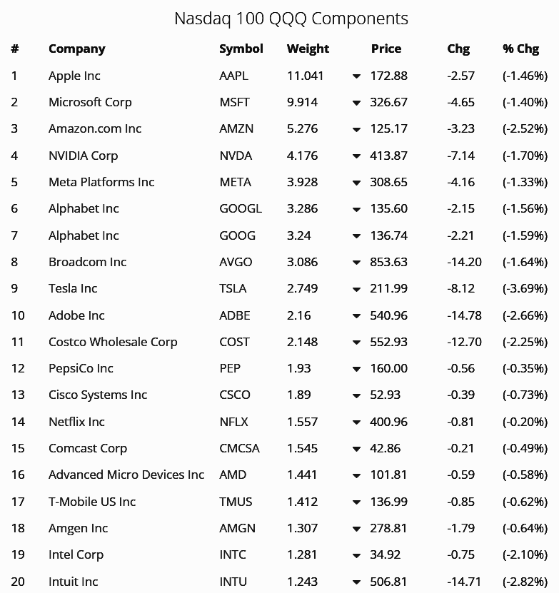
What is QQQ?
PowerShares QQQ ETF
The 100 largest non-financial companies listed on the NASDAQ stock exchange.
Popular for its exposure to tech giants like Apple, Microsoft, Amazon, etc.
Often used by investors to gain exposure to tech sector and large-cap growth stocks.

Slide 4
Experiment Overview
Objective:
Assess the predictability of the realized volatility of the QQQ ETF using a set of macro features.
This experiment aims to build a robust model that can assist in making informed investment decisions.
Hypothesis:
Macro features such as GDP, equities, credit spread, futures, implied volatility, and returns can provide significant predictive power for the realized volatility of QQQ.
Notes:
Zhixing

Slide 5
About the Data
783
Total predictors
4,160
Recorded trading dates (2005-2021)
To predict
Realized Volatility
22 Days Later
182
Original predictors surviving since 2005
881
Rolling dates used to build/test daily models

Slide 6
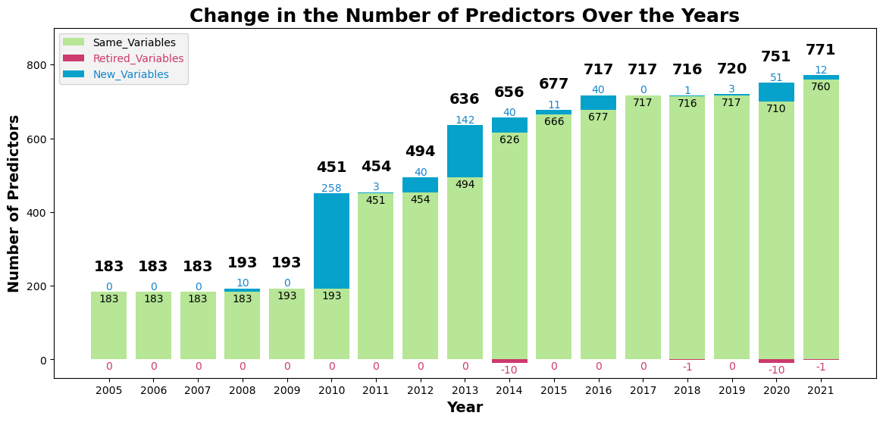
Predictors Evolved Over Time
Notes:
2014: ['ATM_MXN (CME) 1M Vols_lag1d',
'ATM_MXN (CME) 6M Vols_lag1d',
'ATM_MXN (CME) 3M Vols_lag1d',
'ATM_MXN (CME) 2M Vols_lag1d',
'ATM_MXN (CME) 1W Vols_lag1d',
'ATM_MXN (CME) 1M Vols_lag1d_100_period_std_dev_volatility',
'ATM_MXN (CME) 6M Vols_lag1d_100_period_std_dev_volatility',
'ATM_MXN (CME) 3M Vols_lag1d_100_period_std_dev_volatility',
'ATM_MXN (CME) 2M Vols_lag1d_100_period_std_dev_volatility',
'ATM_MXN (CME) 1W Vols_lag1d_100_period_std_dev_volatility']
2018: Macro_UMCSENT
2020: ['ATM_Malting Barley (NYX) 1M Vols_lag1d',
'ATM_Malting Barley (NYX) 6M Vols_lag1d',
'ATM_Malting Barley (NYX) 3M Vols_lag1d',
'ATM_Malting Barley (NYX) 2M Vols_lag1d',
'ATM_Malting Barley (NYX) 1W Vols_lag1d',
'ATM_Malting Barley (NYX) 1M Vols_lag1d_100_period_std_dev_volatility',
'ATM_Malting Barley (NYX) 6M Vols_lag1d_100_period_std_dev_volatility',
'ATM_Malting Barley (NYX) 3M Vols_lag1d_100_period_std_dev_volatility',
'ATM_Malting Barley (NYX) 2M Vols_lag1d_100_period_std_dev_volatility',
'ATM_Malting Barley (NYX) 1W Vols_lag1d_100_period_std_dev_volatility']
2021: ['Macro_USSLIND']

Slide 7
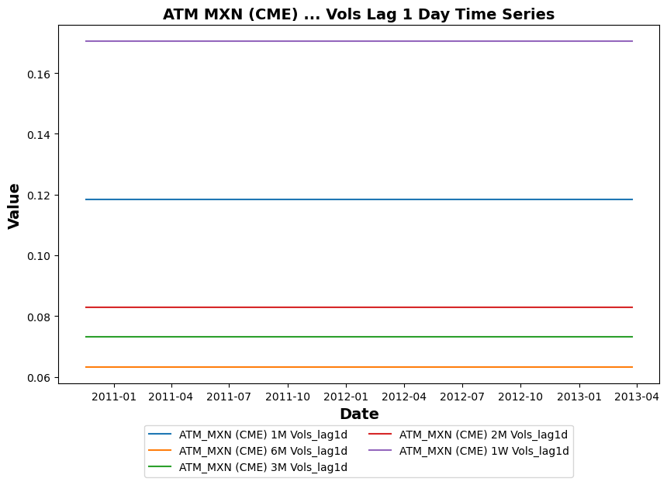
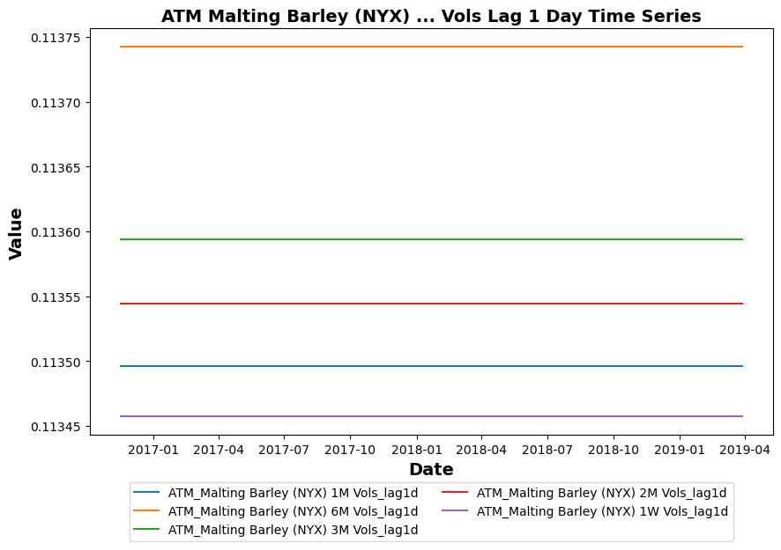
Why Were Predictors Dropped?
They were constant (NAN correlation)
Notes:
2014: ['ATM_MXN (CME) 1M Vols_lag1d',
'ATM_MXN (CME) 6M Vols_lag1d',
'ATM_MXN (CME) 3M Vols_lag1d',
'ATM_MXN (CME) 2M Vols_lag1d',
'ATM_MXN (CME) 1W Vols_lag1d',
'ATM_MXN (CME) 1M Vols_lag1d_100_period_std_dev_volatility',
'ATM_MXN (CME) 6M Vols_lag1d_100_period_std_dev_volatility',
'ATM_MXN (CME) 3M Vols_lag1d_100_period_std_dev_volatility',
'ATM_MXN (CME) 2M Vols_lag1d_100_period_std_dev_volatility',
'ATM_MXN (CME) 1W Vols_lag1d_100_period_std_dev_volatility']
2020: ['ATM_Malting Barley (NYX) 1M Vols_lag1d',
'ATM_Malting Barley (NYX) 6M Vols_lag1d',
'ATM_Malting Barley (NYX) 3M Vols_lag1d',
'ATM_Malting Barley (NYX) 2M Vols_lag1d',
'ATM_Malting Barley (NYX) 1W Vols_lag1d',
'ATM_Malting Barley (NYX) 1M Vols_lag1d_100_period_std_dev_volatility',
'ATM_Malting Barley (NYX) 6M Vols_lag1d_100_period_std_dev_volatility',
'ATM_Malting Barley (NYX) 3M Vols_lag1d_100_period_std_dev_volatility',
'ATM_Malting Barley (NYX) 2M Vols_lag1d_100_period_std_dev_volatility',
'ATM_Malting Barley (NYX) 1W Vols_lag1d_100_period_std_dev_volatility']

Slide 8
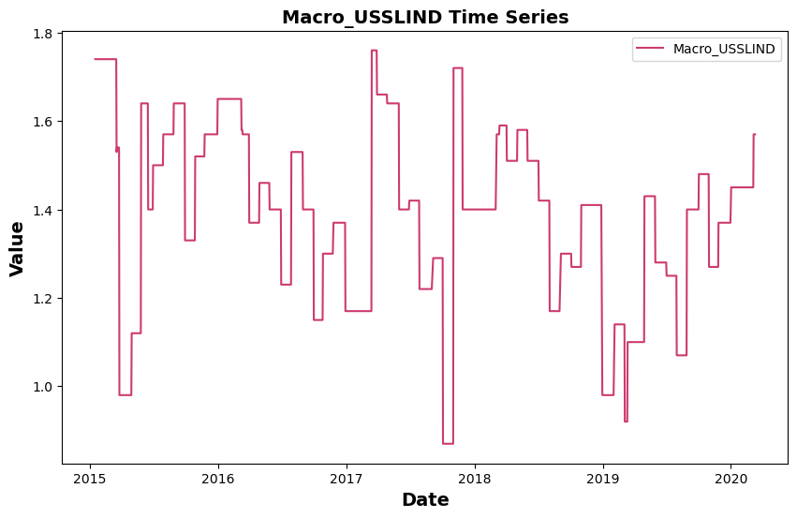
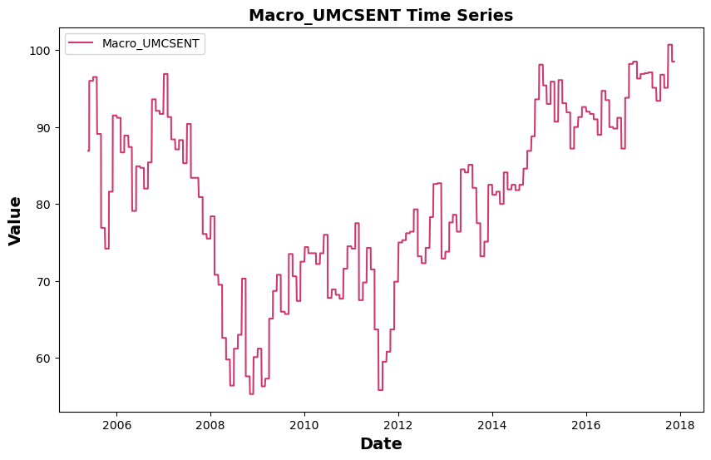
Why Were 12 Predictors Dropped?
Leading Index
for the United States
University of Michigan
Consumer Sentiment
Notes:
Zhixing

Slide 9
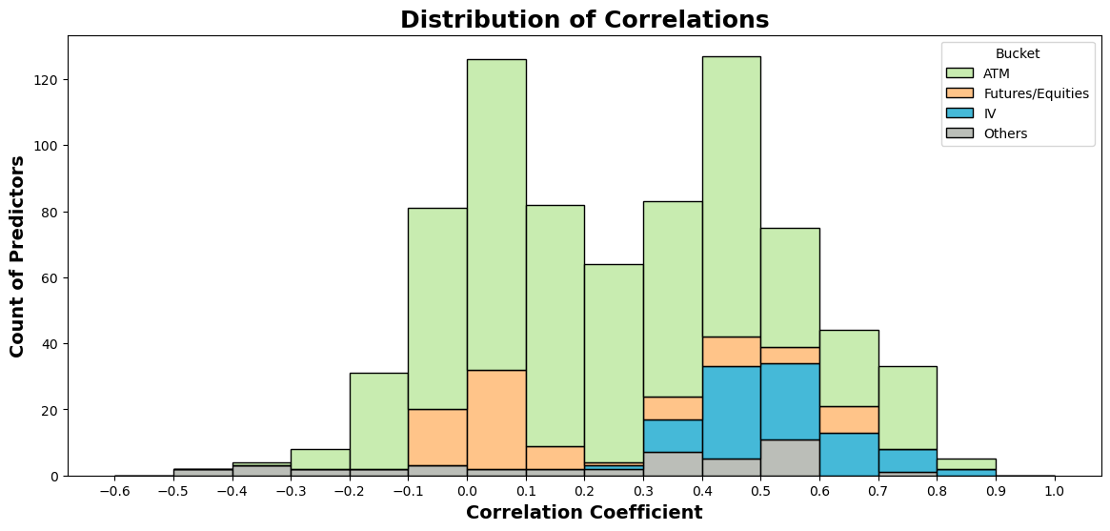
Most Positive Correlation: IV and ATM
Many poorly correlated predictors are
ATMs, Futures, and Equities
Many highly correlated predictors are
ATMs and IVs
Notes:
'3m', 'ATM', 'BofA', 'CP', 'Equities', 'Futures', 'IV', 'MSCI', “'Macro', 'NIKKEI', 'SPX', 'US'

Slide 10
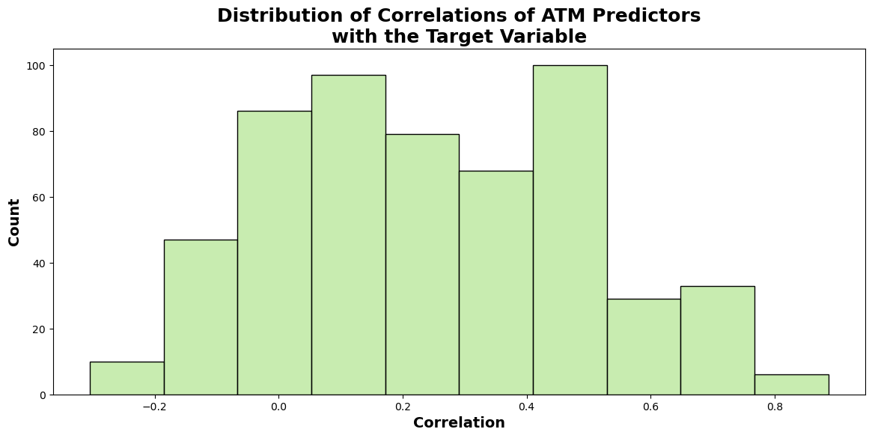
ATM Predictors
560
out of 783
predictors
Notes:
Zhixing

Slide 11
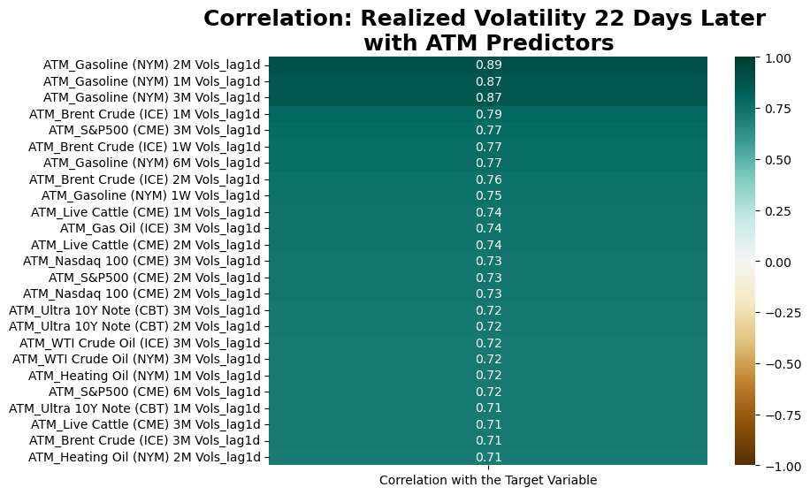
ATM Energy Predictors Have High Impact
51
out of 560
ATM Predictors
has an absolute
correlation
more than 0.6
Notes:
Results also point out that technology stocks are positively and significantly affected by crude oil prices, which indicates that increasing crude oil prices put more pressure on technology firms to lower their energy-related costs and innovate more energy-conserving products due to high demand from other sectors.

Slide 12
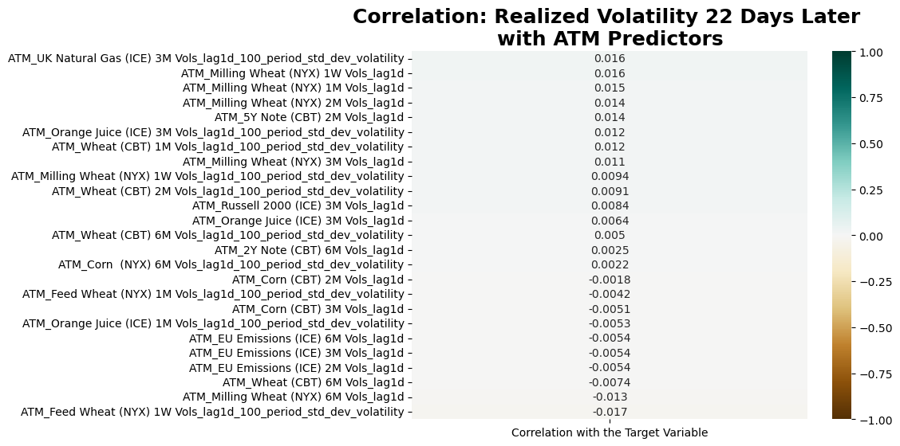
ATM Agri/Emission Predictors Have Less Impact
155
out of 560
ATM Predictors
has an absolute
correlation
less than 0.1
Notes:
Zhixing

Slide 13
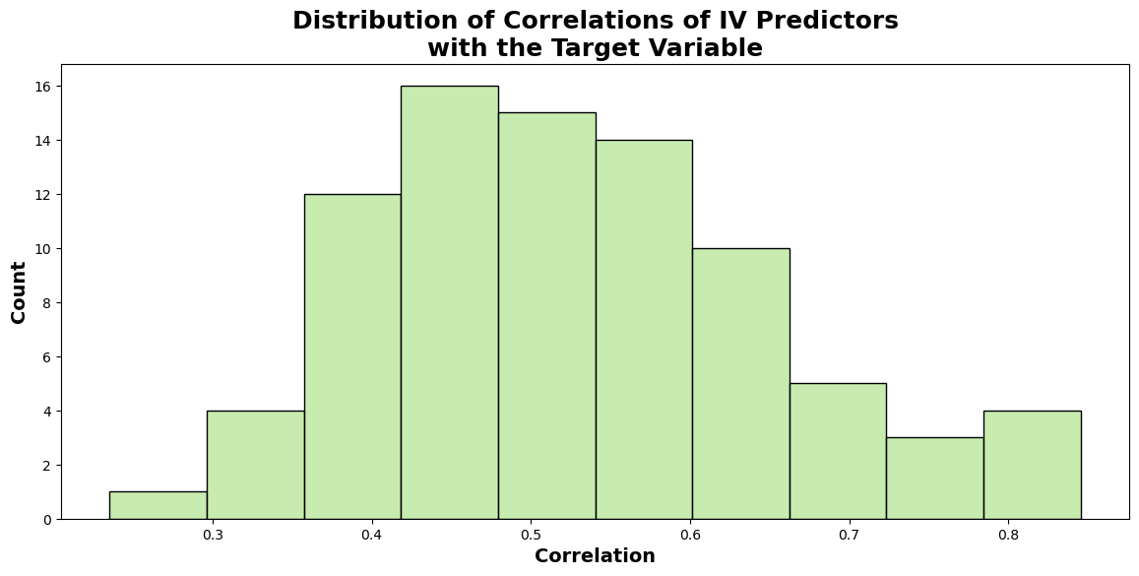
IV Predictors: Highly Correlated
84
out of 783
predictors
Notes:
Zhixing

Slide 14
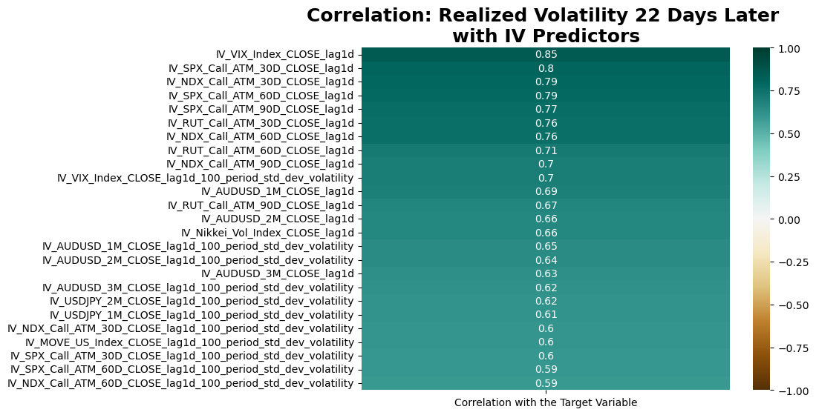
IV Predictors: Highly Correlated
22
out of 84
IV Predictors
has an absolute
correlation
more than 0.6
Notes:
VIX index: a popular measure of the stock market's expectation of volatility based on S&P 500 index options
SPX: is a stock market index tracking the stock performance of 500 of the largest companies listed on stock exchanges in the United States
NDX: The Nasdaq-100 is a stock market index made up of 101 equity securities issued by 100 of the largest non-financial companies listed on the Nasdaq stock exchange
RUT: Russell is a small-cap U.S. stock market index

Slide 15
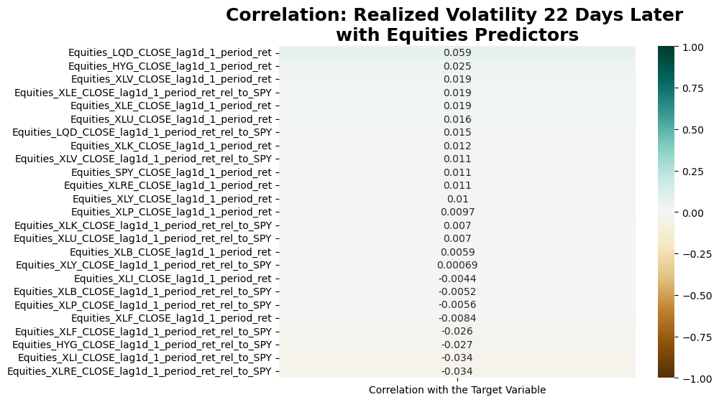
Equities Predictors: Many Poorly Correlated
25
out of 38
Equities Predictors
has an absolute
correlation
less than 0.1
Notes:
Zhixing

Slide 16
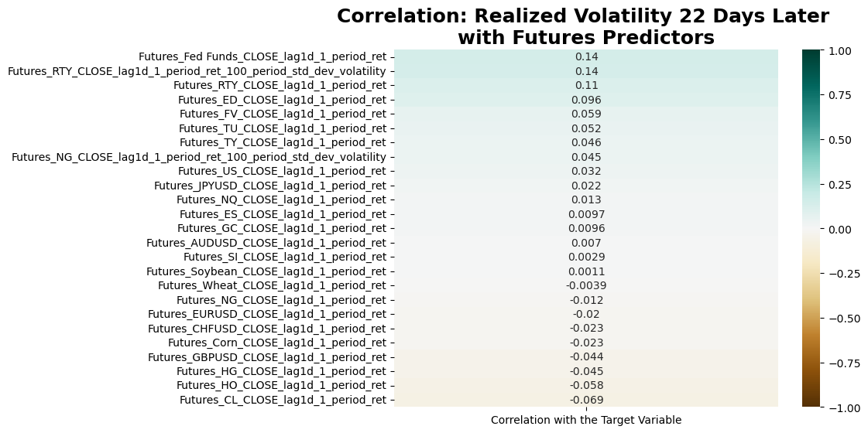
Futures Predictors: Many Poorly Correlated
22
out of 46
Futures Predictors
has an absolute
correlation
less than 0.1
Notes:
Zhixing

Slide 17
Outlier Detection
Why Winsorization?
Notes:
Zhixing

Slide 18
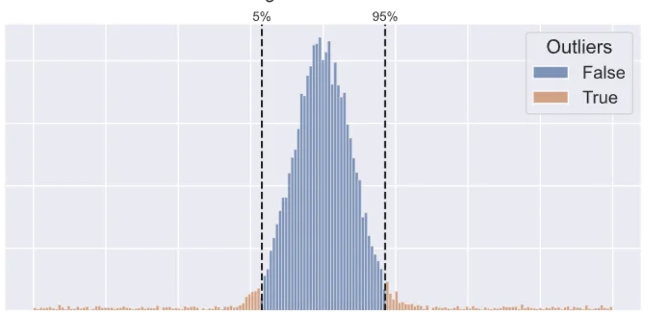
Investigating outliers and bad data
Instead of removing extreme values that distort the overall picture of data, we adjust them
16 variables have max value greater than 1^10
95% of distribution is taken - high extreme values are changed for the value at 95th percentile, low values changed for value at 5th percentile
Benefits of Winsorization:
Reduces Skewness: Makes our data less tilted towards extremes
Preserves Data: Instead of deleting extreme values, we adjust them, so we don't lose information
Robust Analysis: Helps in producing reliable results when analyzing data, especially in statistical analysis
Notes:
Zhixing

Slide 19
Findings after Winsorization
After adjusting for outliers following variables persisted with still very high extreme values greater than 1^10:
Implied Volatility of (1, 2, 3 and 6 month) ATM option on Fed Funds Futures
Standard Deviation of Implied Volatility over 100 days of (1,2,3, and 6 month) Fed Funds Futures
Implied Volatility of (1, 2, 3 and 6 month) ATM option on EU Emission allowances
Standard Deviation of Implied Volatility over 100 days of ATM EU Emission allowances
Notes:
Zhixing

Slide 20
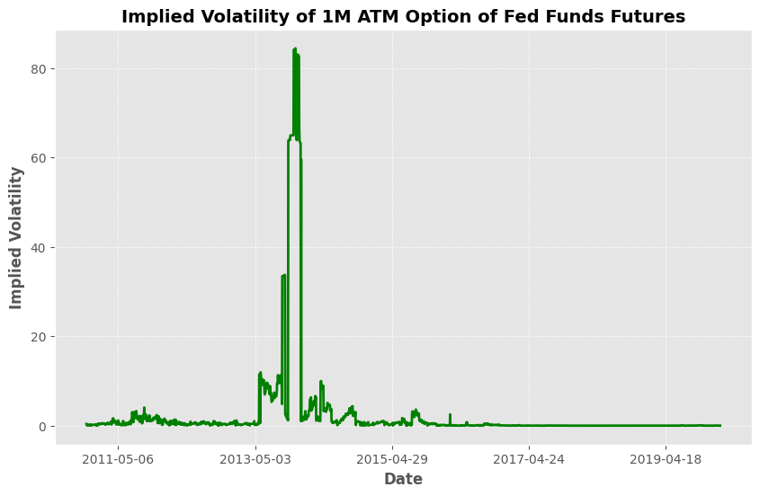
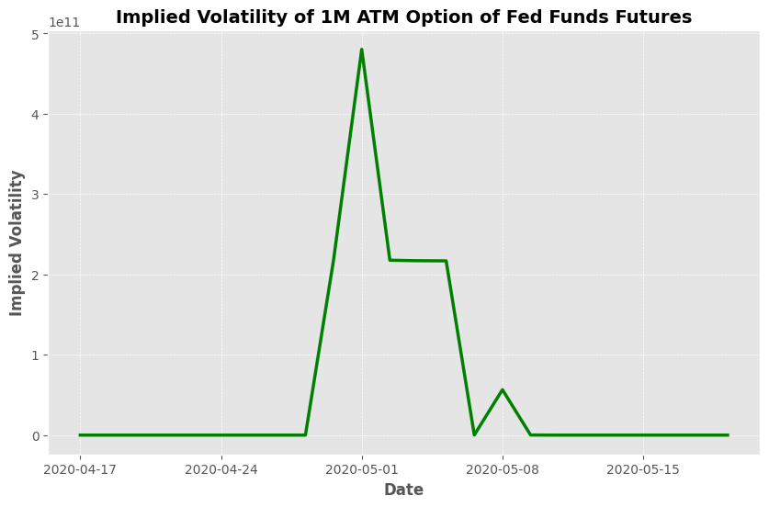
Analyzing Extreme Values
IV of 1M ATM Option of Fed Funds before and after 2020
Notes:
Zhixing

Slide 21
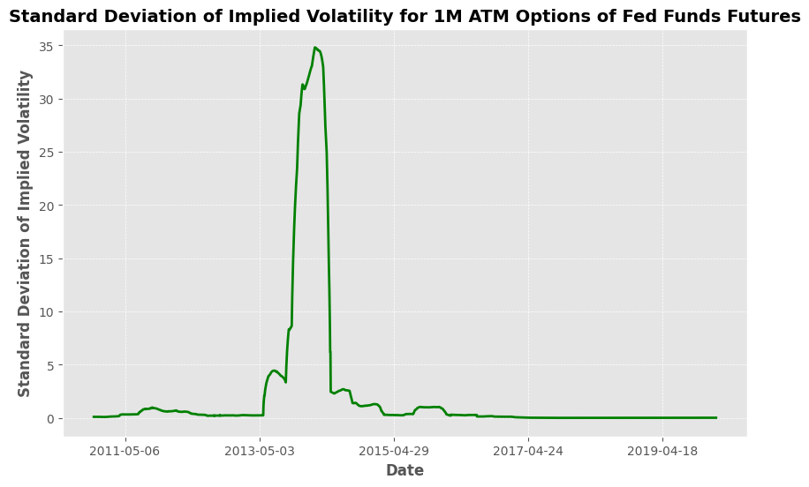
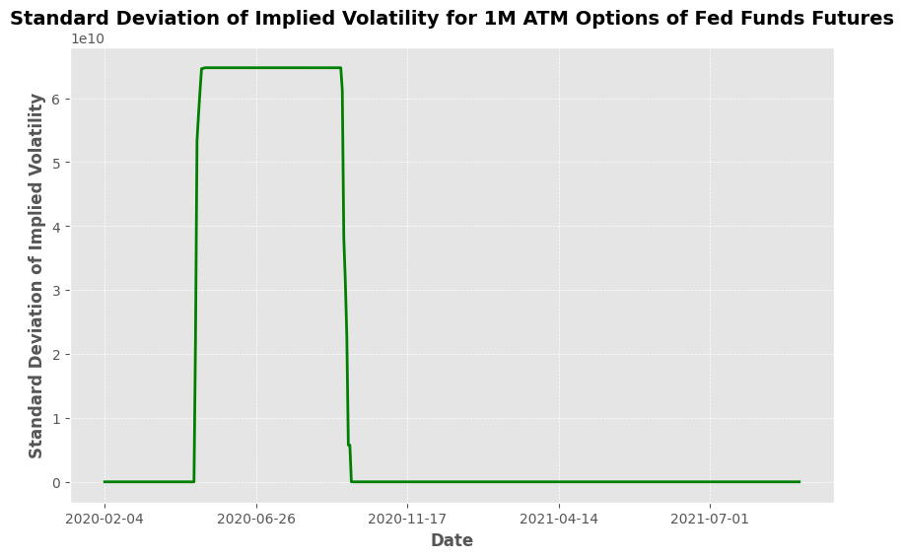
Analyzing Extreme Values
Standard Deviation of IV for 1 M ATM Options of Fed Funds Futures
Notes:
Zhixing

Slide 22
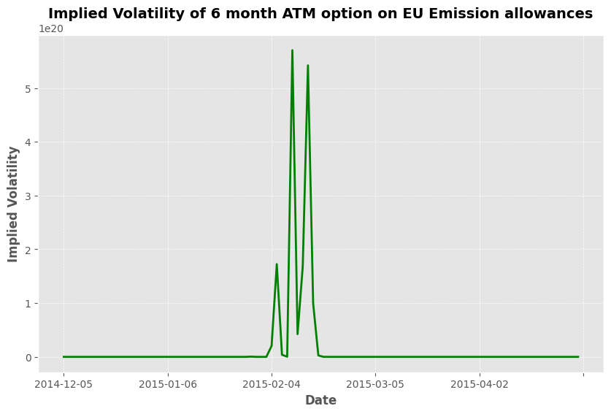
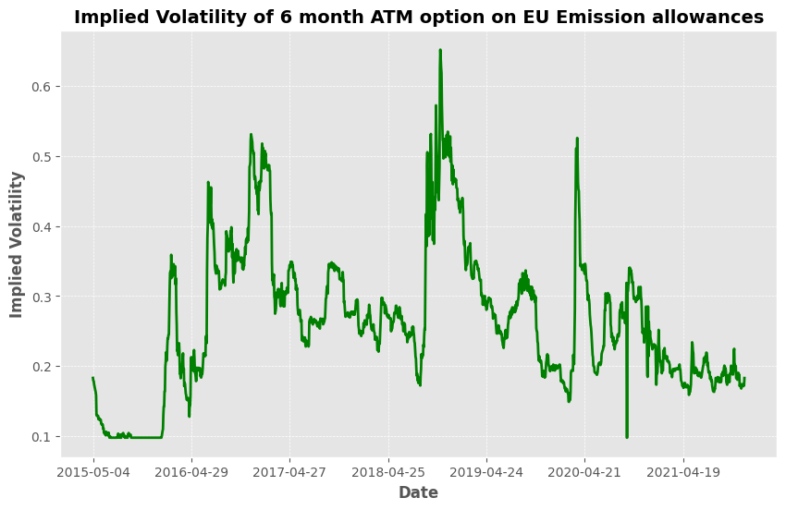
Analyzing Extreme Values
Implied Volatility of 6M ATM option on EU Emission Allowance before and after 2015
Notes:
Zhixing

Slide 23
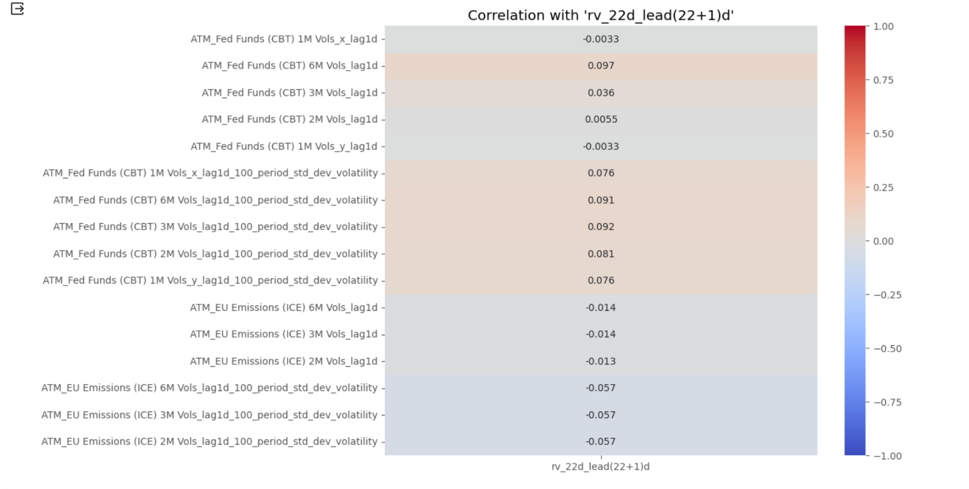
Analyzing Extreme Values
Notes:
Zhixing

Slide 24
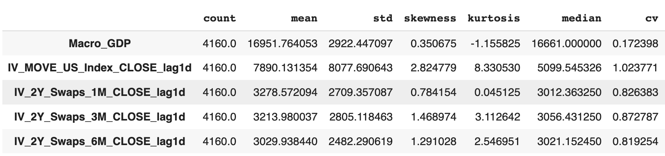
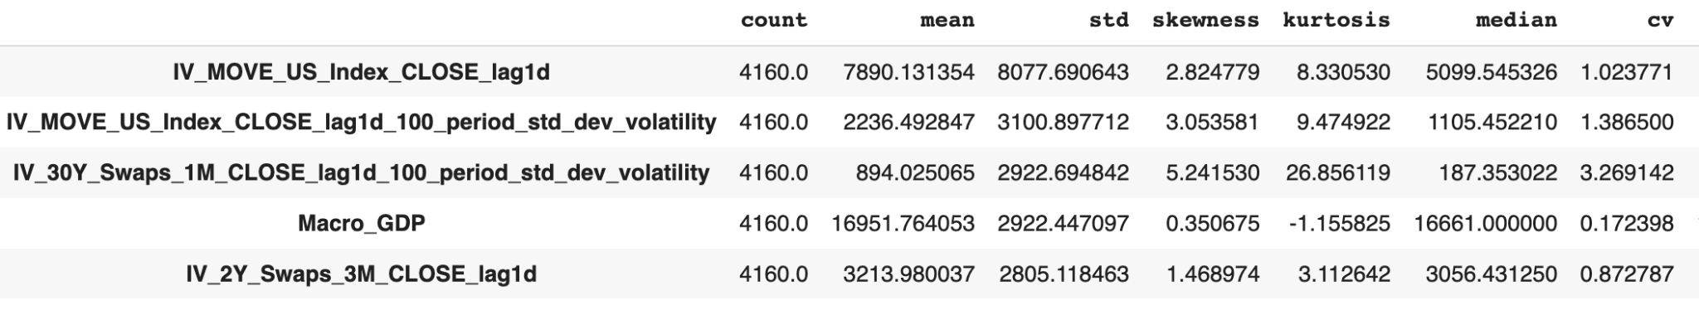
Summary Stats
Top 5 by Mean
Top 5 by SD
Notes:
Zhixing

Slide 25
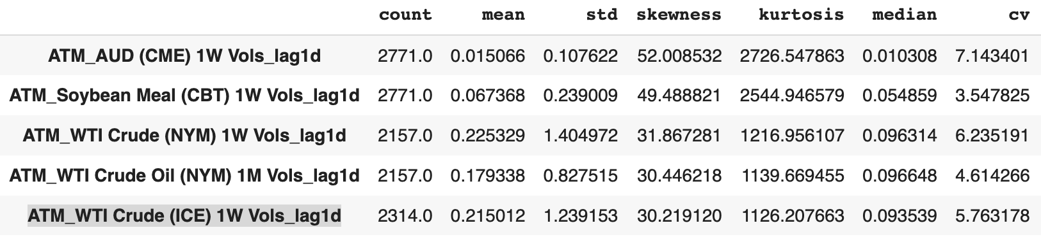
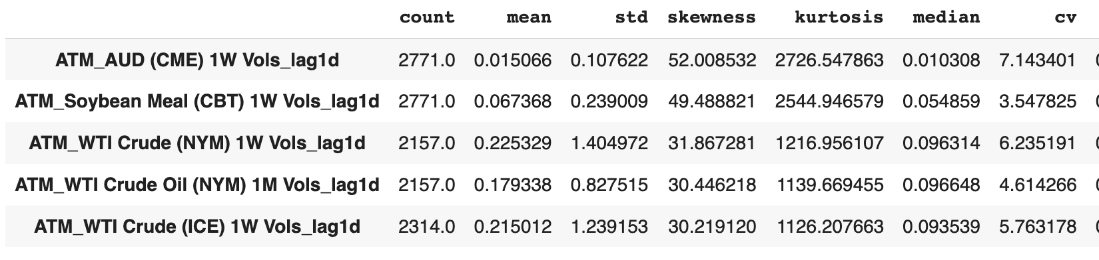
Summary Stats
Top 5 by skewness
Top 5 by Kurtosis
Notes:
Zhixing

Slide 26
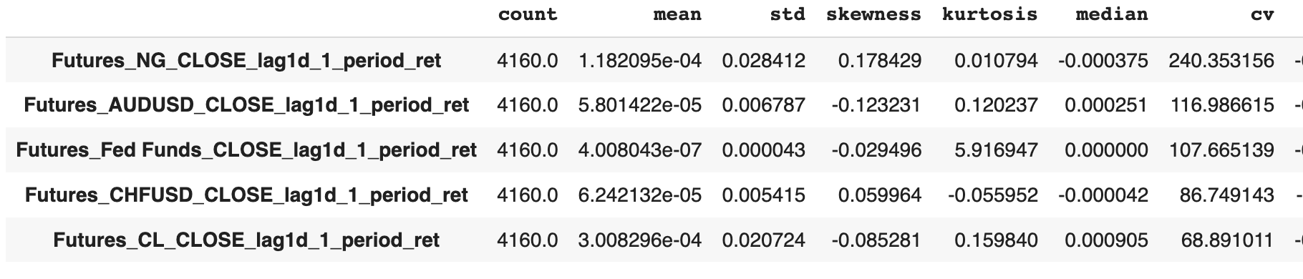
Summary Stats
Top 5 by CV
Notes:
Zhixing

Slide 27
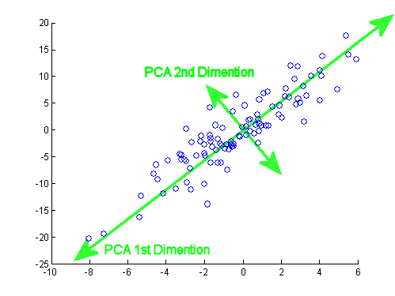
Principal Component Analysis
Dimensionality Reduction
Explains Maximum Variance
Does not lose key characteristics
Less Complexity
Notes:
Zhixing

Slide 28
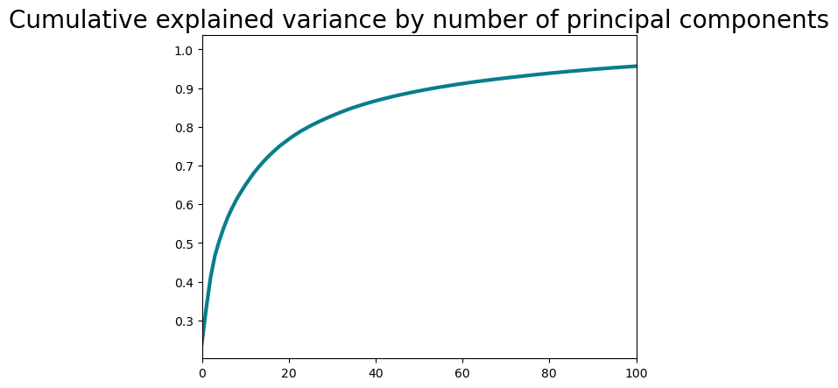
Principal Component Analysis
Notes:
Zhixing

Slide 29
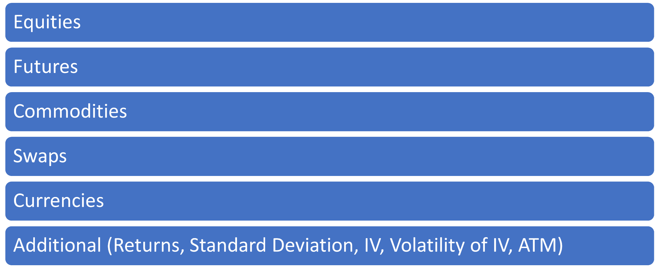
Bucketing
Notes:
Zhixing

Slide 30
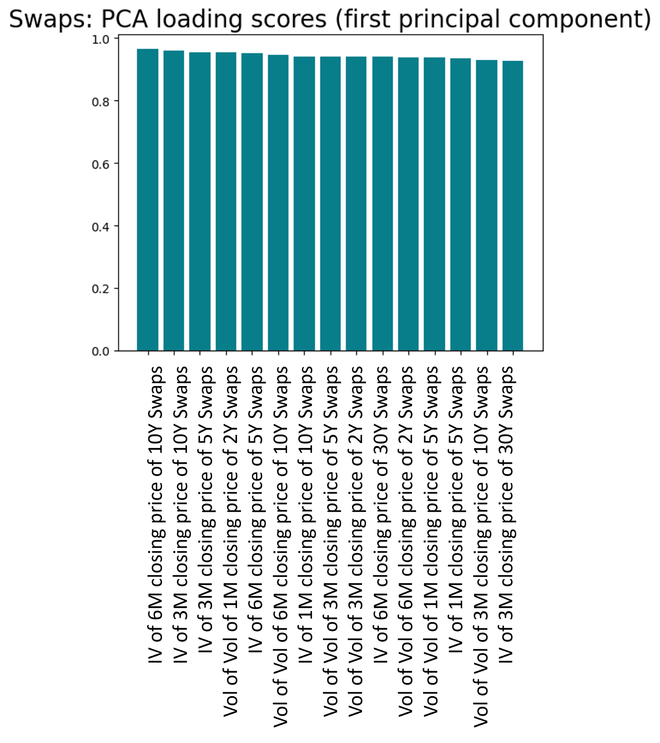
Swaps
Implied Volatility and Vol of Vol are the most defining variables for explaining Swaps
IV of 3M and 6M Close of 10Y Swaps most conclusive
Notes:
Zhixing

Slide 31
Most Contributing Variables
Buckets | Variable Name
Equities | Std Deviation over 100 day period for returns prices of SPY Close
Equities | Std Deviation over 100 day period for returns prices of XLI Close
Futures | Std Deviation over 100 day period for return prices of AUD-USD Close
Futures | Std Deviation over 100 day period for return prices of EUR-USD Close
Commodities | Std Deviation over 100 day period for volatility of 3M ATM Gas Oil (ICE)
Commodities | Std Deviation over 100 day period for volatility of 3M ATM Heating Oil (NYM)
Currency | Implied Volatility of 3M EUR-USD Close
Currency | Implied Volatility of 2M EUR-USD Close
Notes:
Zhixing

Slide 32
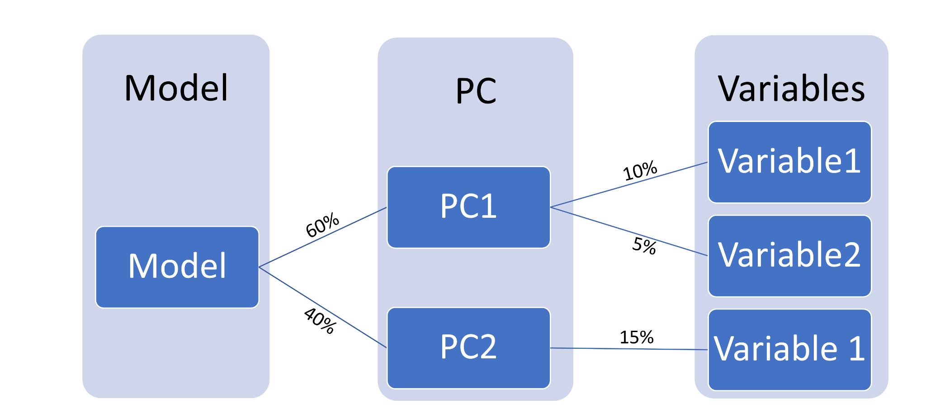
Weighted Average of Contribution of Variables
Notes:
Zhixing

Slide 33
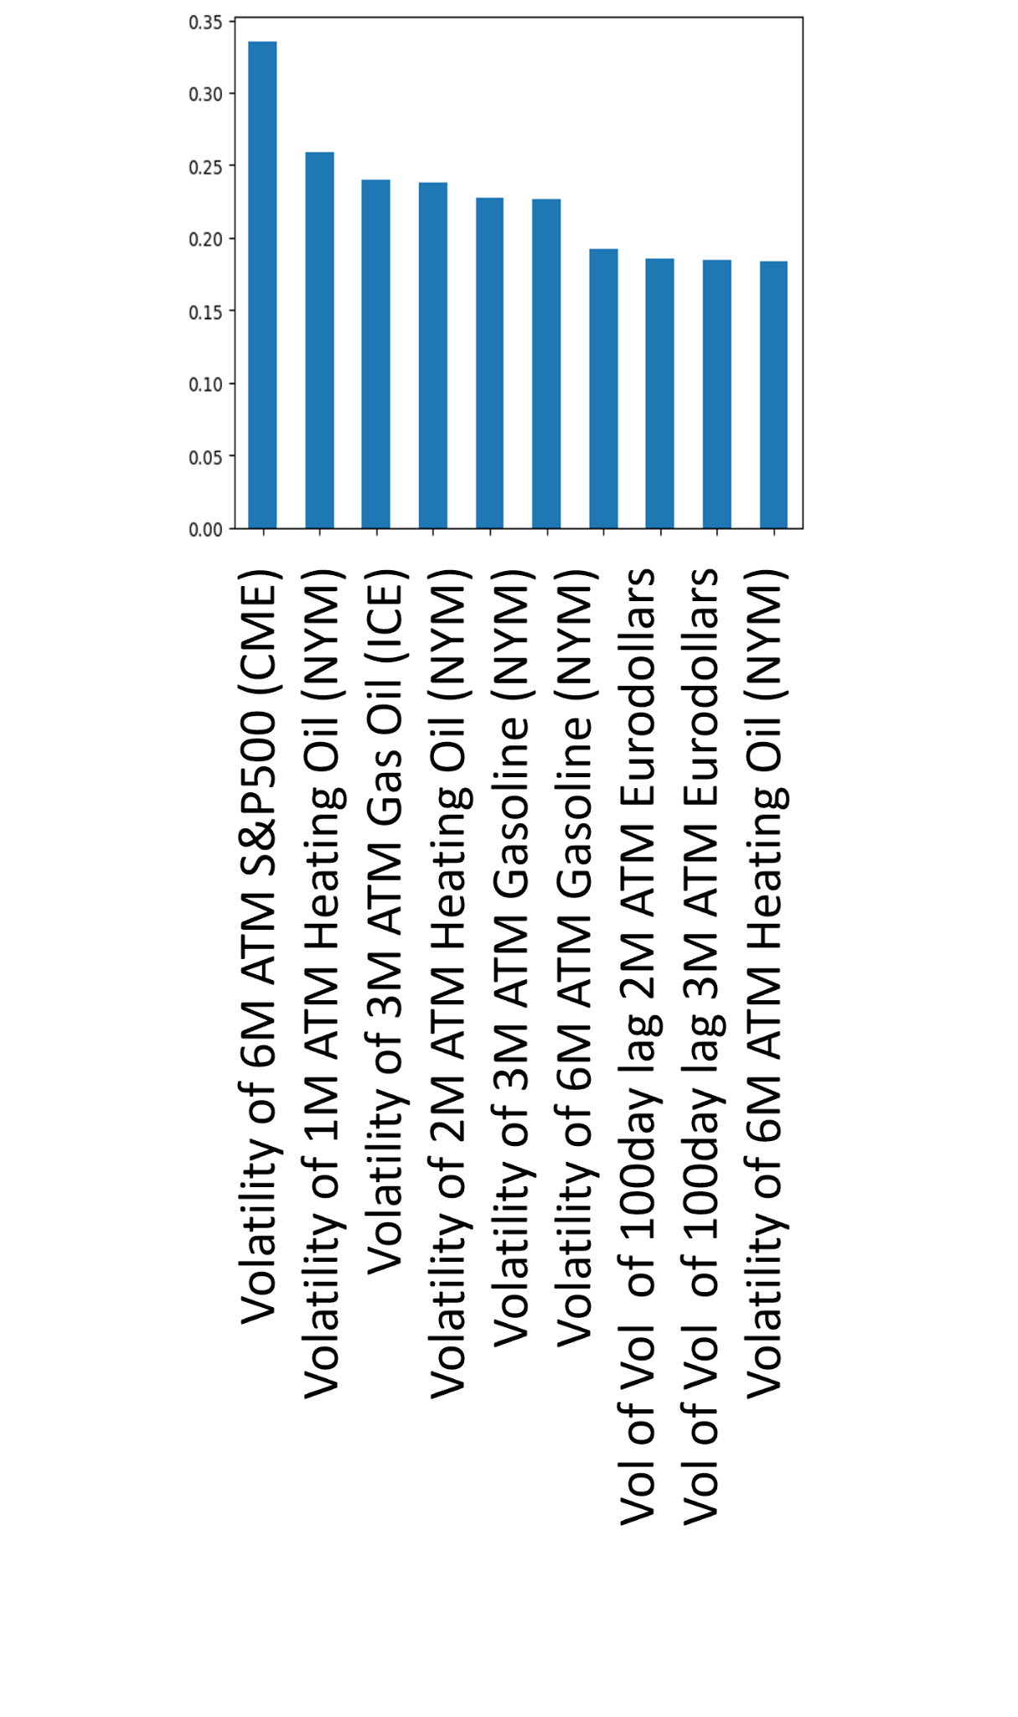
Variables contributing the most to all PCs
(Weighted Average)
Correlation to Target

Slide 34
PCA: Explained Variance

Slide 35
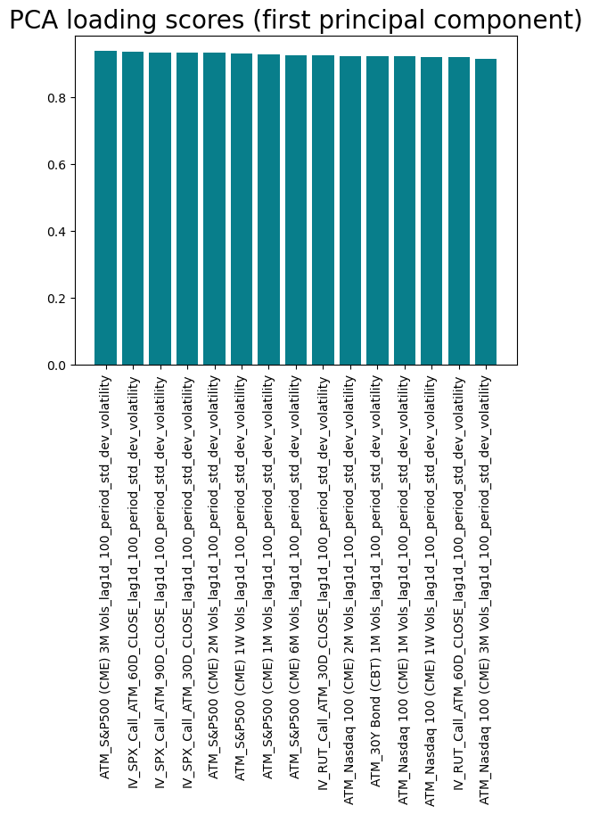
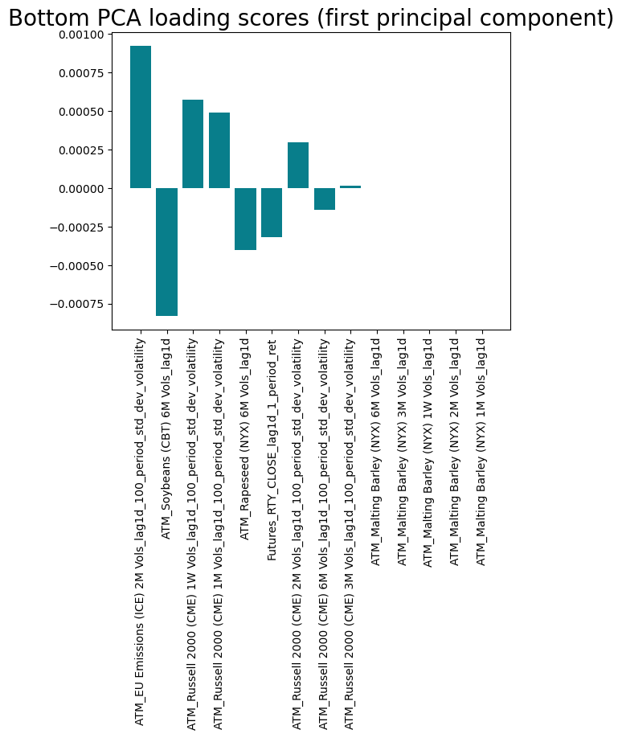
Notes:
This thing supports my correction analysis about

Slide 36
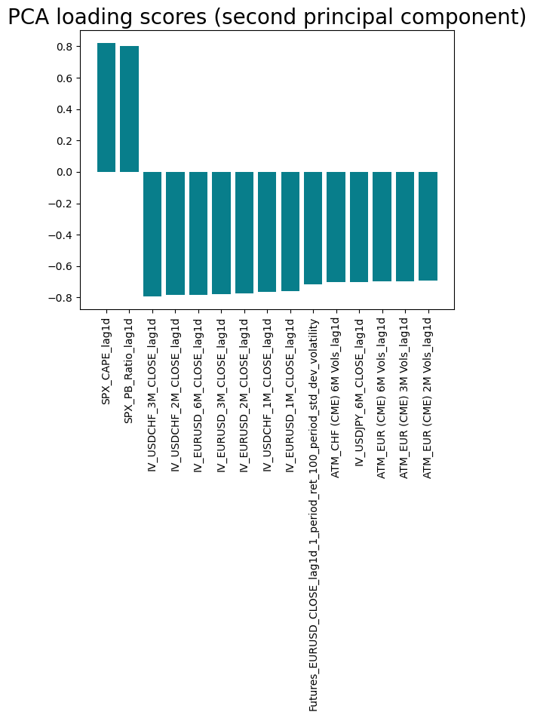
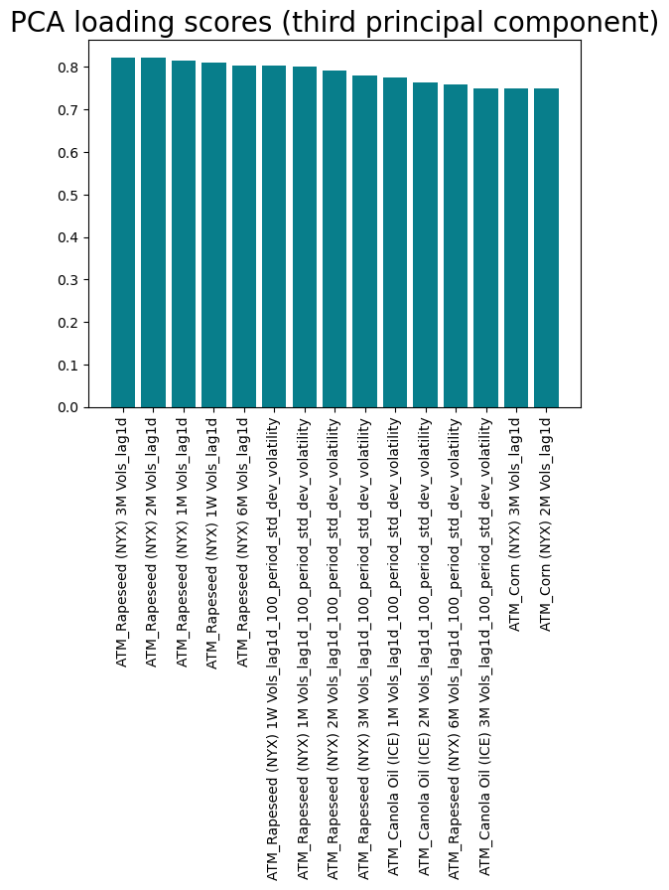

Slide 37
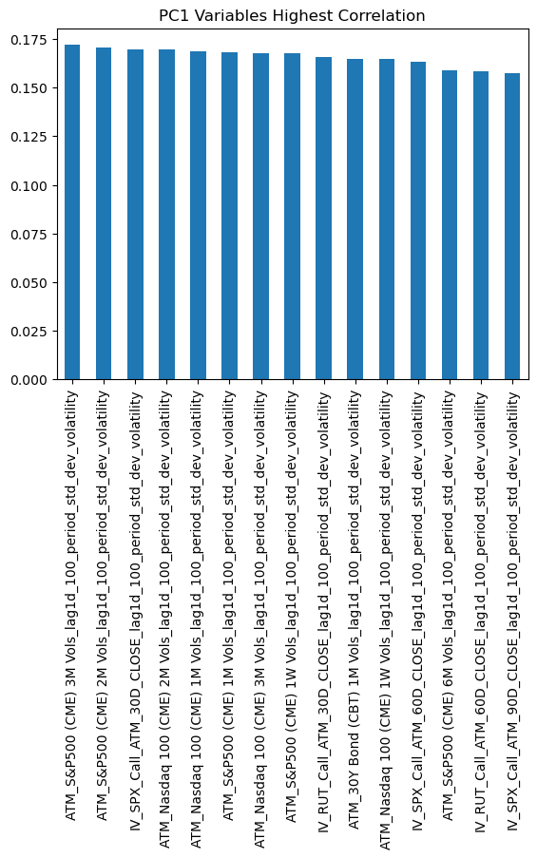
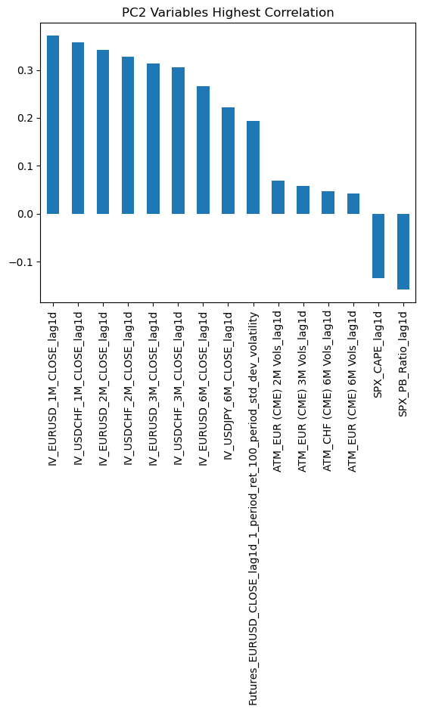

Slide 38
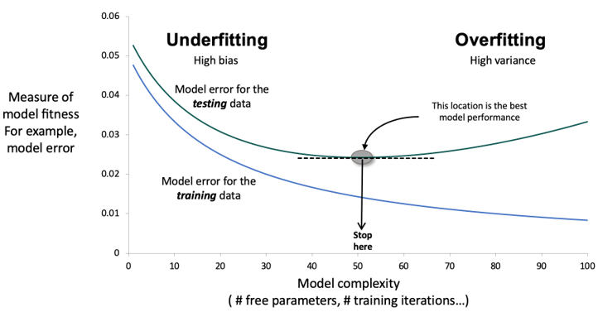
Methodology for Model Selection
After completing the feature selection (PCA, Autoencoder …), we will run several models to find out the best model for prediction
Starting from linear model as baseline and moving deeper to non-linear models and deep learning models.
For each type of models, fine-tuning the model complexity to avoid underfitting and overfitting, as the graph shown
For complicated models that have randomness, run them multiple times and using the average as model performance.

Slide 39
Model Selection: Linear Models
Linear models are robust, hard to make mistakes. Nonlinear models are easy to make mistakes, especially when using complicated model
A linear model result gives a baseline. Nonlinear models should always do at least as good as a linear model
Y=β0​+β1​X1​+β2​X2​+…+βp​Xp​+ϵ, where X1 ​,X2 ​ ,…,Xp ​ represent the multiple independent variables, β0 ​,β1 ​ ,β2 ​ ,…,βp ​ are the parameters to be estimated
Notes:
Zhixing

Slide 40
Model Selection: Non-Linear Models
There are many types of Nonlinear machine learning models. We want to focus on the models that fit the nature of our dataset (Financial Data, Time Series Components, High Randomness).
Start with minimal complexity, increase complexity until overfitting (training substantially better than testing). Then back off to choose the lowest complexity that gives sufficiently good testing results.
Applying the method above on several models and listing the performances. Evaluating the model based on their accuracy, robustness, and interpretability… .
Potential Models:
Random Forest
Gradient Boosting
Support Vector Regression
Notes:
Zhixing

Slide 41
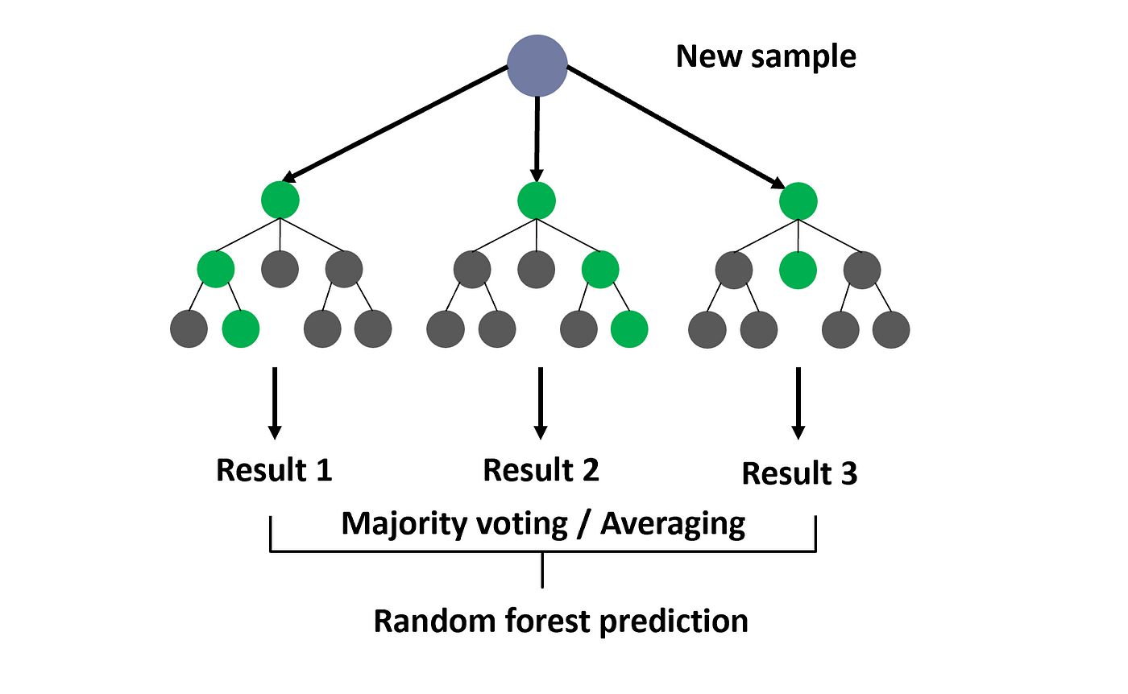
Random Forest:
Notes:
Zhixing

Slide 42
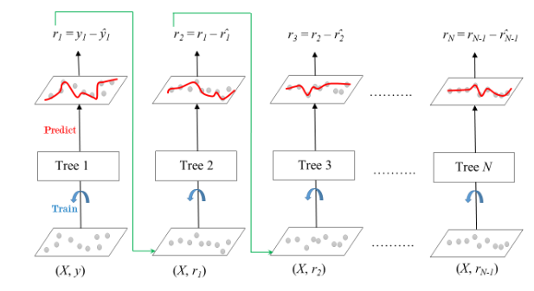
Gradient Boosting:
Notes:
Zhixing

Slide 43
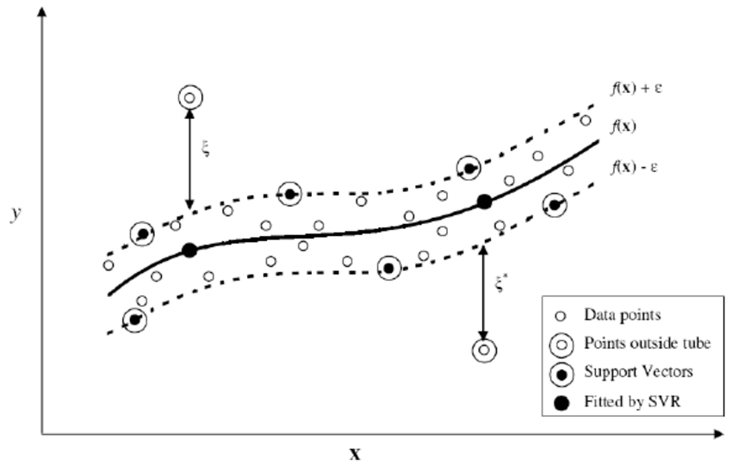
SVR:
Notes:
Zhixing

Slide 44
Model Selection: Deep Learning
Deep Learning models are more complex non-linear models. We will focus on Neural Network models. The approach of creating and evaluating deep learning models is similar to non-linear models.
Time efficiency might be a big limitation when modeling by deep learning model. Considering use GPU CUDA will increase the speed of training, especially for larger and more complex deep learning architectures.
Potential Model:
Neural Networks(NN) & Recurrent Neural Networks (RNN)
Long Short-Term Memory & Gated Recurrent Unit (Variants of RNN)
Notes:
Zhixing

Slide 45
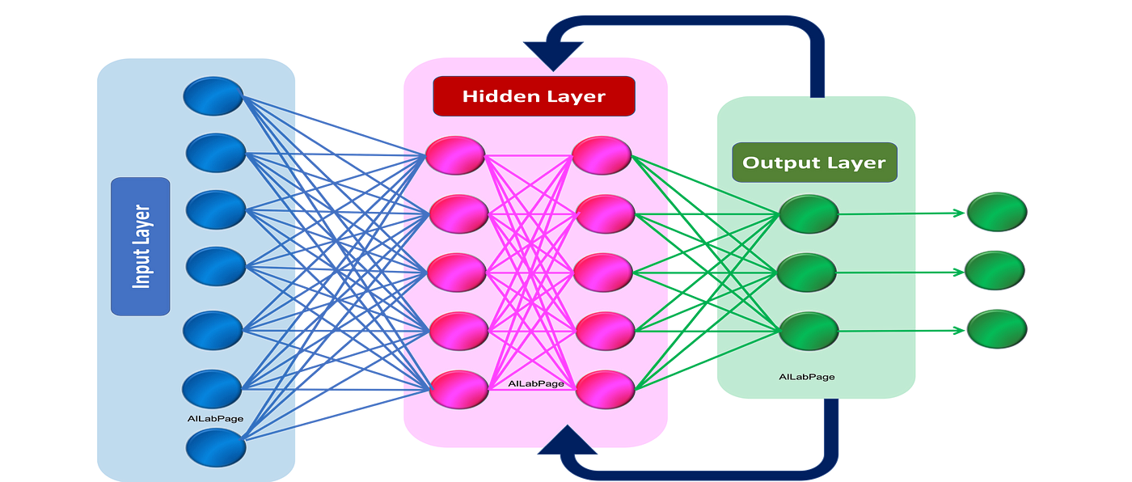
Recurrent Neural Networks:
Notes:
Zhixing

Slide 46
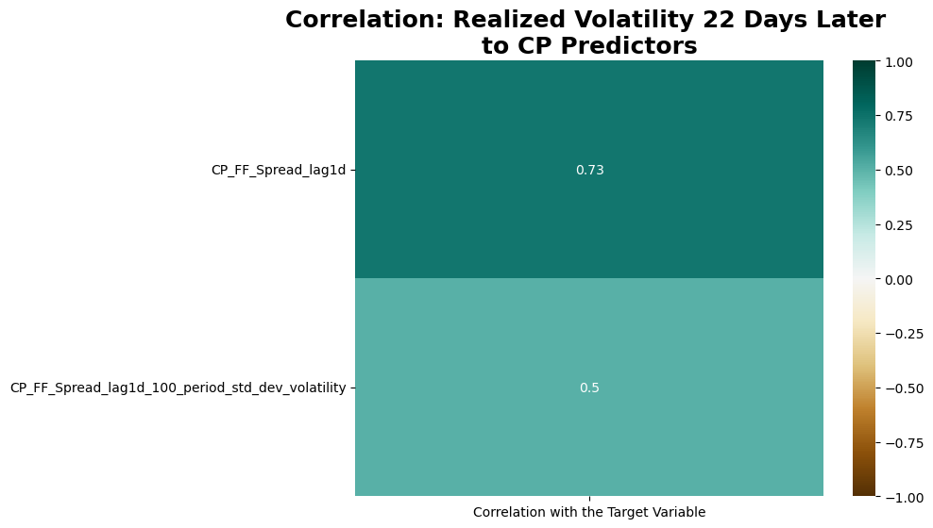
CP Predictors: Highly Correlated

Slide 47
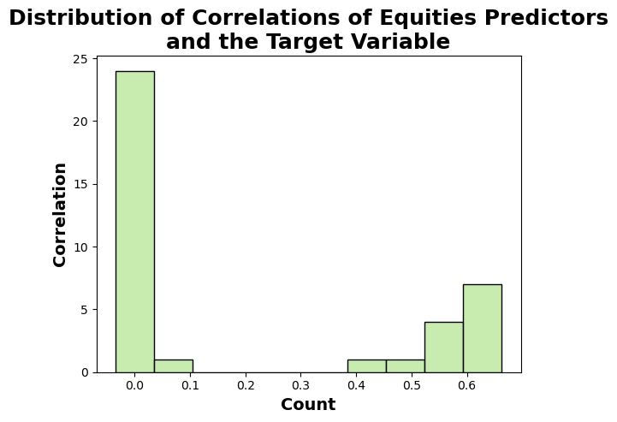
Equities Predictors:

Slide 48
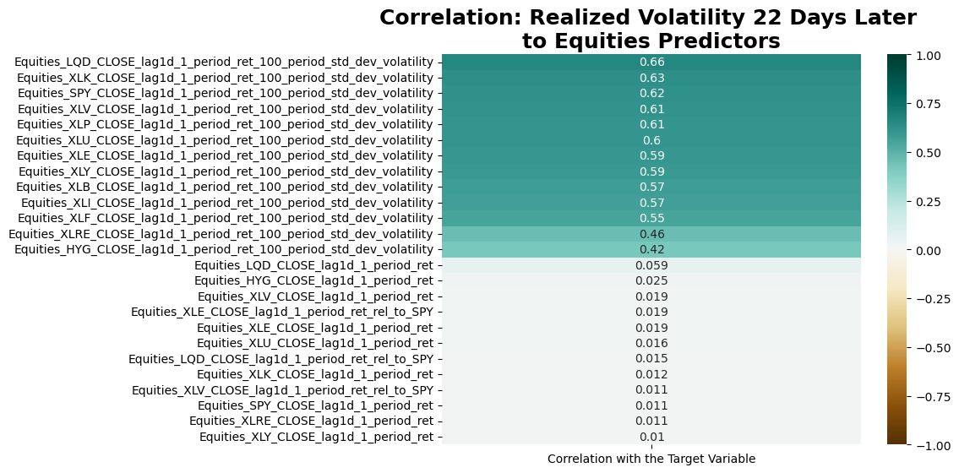
Equities Predictors:

Slide 49
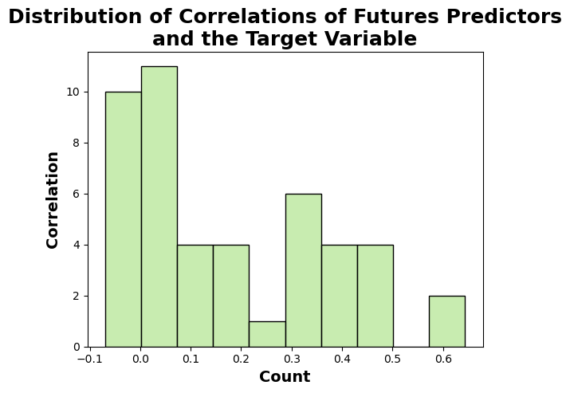
Futures Predictors:
Notes:
2014: ['ATM_MXN (CME) 1M Vols_lag1d',
'ATM_MXN (CME) 6M Vols_lag1d',
'ATM_MXN (CME) 3M Vols_lag1d',
'ATM_MXN (CME) 2M Vols_lag1d',
'ATM_MXN (CME) 1W Vols_lag1d',
'ATM_MXN (CME) 1M Vols_lag1d_100_period_std_dev_volatility',
'ATM_MXN (CME) 6M Vols_lag1d_100_period_std_dev_volatility',
'ATM_MXN (CME) 3M Vols_lag1d_100_period_std_dev_volatility',
'ATM_MXN (CME) 2M Vols_lag1d_100_period_std_dev_volatility',
'ATM_MXN (CME) 1W Vols_lag1d_100_period_std_dev_volatility']
2018: Macro_UMCSENT
2020: ['ATM_Malting Barley (NYX) 1M Vols_lag1d',
'ATM_Malting Barley (NYX) 6M Vols_lag1d',
'ATM_Malting Barley (NYX) 3M Vols_lag1d',
'ATM_Malting Barley (NYX) 2M Vols_lag1d',
'ATM_Malting Barley (NYX) 1W Vols_lag1d',
'ATM_Malting Barley (NYX) 1M Vols_lag1d_100_period_std_dev_volatility',
'ATM_Malting Barley (NYX) 6M Vols_lag1d_100_period_std_dev_volatility',
'ATM_Malting Barley (NYX) 3M Vols_lag1d_100_period_std_dev_volatility',
'ATM_Malting Barley (NYX) 2M Vols_lag1d_100_period_std_dev_volatility',
'ATM_Malting Barley (NYX) 1W Vols_lag1d_100_period_std_dev_volatility']
2021: ['Macro_USSLIND']

Slide 50
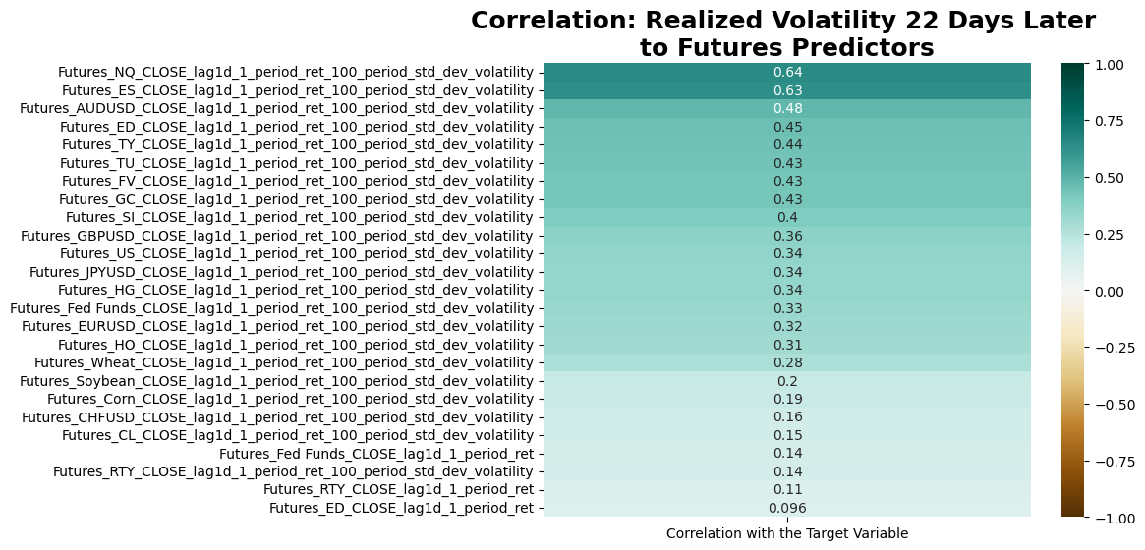
Futures Predictors:
Notes:
Zhixing

Slide 51
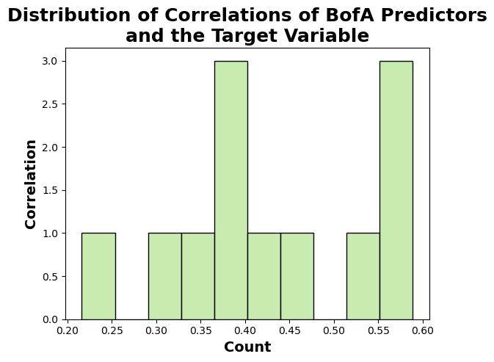
BofA Predictors: Fairly Correlated
Notes:
Zhixing

Slide 52

BofA Predictors: Fairly Correlated:
Notes:
Zhixing

Slide 53

SPX Predictors:
Notes:
Zhixing

Slide 54

MSCI Predictors:
Notes:
Zhixing

Slide 55

3M Predictors
Notes:
Zhixing

Slide 56

US Swap Spread Predictors:
Notes:
Zhixing

Slide 57

Macro Predictors:
Notes:
Zhixing

Slide 58

NIKKEI Predictors:
Notes:
Zhixing

Slide 59


About the Data
Notes:
Zhixing

Slide 60
Thank you!

